Slide 1
Experiments in Integrated Data Center Power and Cooling Analysis
Shaun Brandt, Hema Kumar, Michael Novak, Mandar Patil, Yu Yang
Portland State University

Slide 2
About the Project
The need for large scale computing continues to rise, and companies are turning to data centers to meet those needs
Large clusters of servers are expensive to run, and expensive to cool
Cooling devices (especially chillers) consume lots of power and are subject to physical wear
Data center operators need access to as much information as possible!

Slide 3
About the Data
Data for this project was collected from a number of sensors at the PNNL Energy Smart Data Center
8 server racks (1 network, 2 air cooled, 5 liquid cooled)
Two application loads (high density / low density)
Three different application test runs

Slide 4
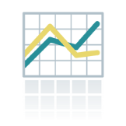
Project Design
Analysis with Scripts
Analysis with Perftrack
Perftrack Data
Raw Data
PTDF
PTDF
CSV
CSV
Add To Database
Process Raw Data
Database Engine
Plot Graphs
Cluster Data
Perftrack
Image Files
Get Data from Database
Plot Graphs
Cluster Data
Graphical User Interface

Slide 5
Approach 1: Analysis with Scripts
A set of custom tools was written to work with sensor data provided in CSV format
Mostly Haskell with calls to Gnuplot (earlier prototypes also used C, Perl and shell)
Generates a complete report including tables and graphs
Calculates and graphs metrics such as temperature deltas, COP (coefficient of performance) and power usage

Slide 6
Analysis with Scripts (cont.)
Cluster analysis based on output of metric calculations
Our work uses ELKI, an open source data mining tool with many customizable options (such as choice of clustering algorithms)
We tried clustering on various metrics, including chiller water temperature deltas, coefficient of performance (COP) and cooling load
We developed a method to overlay cluster information over previously generated graphs

Slide 7
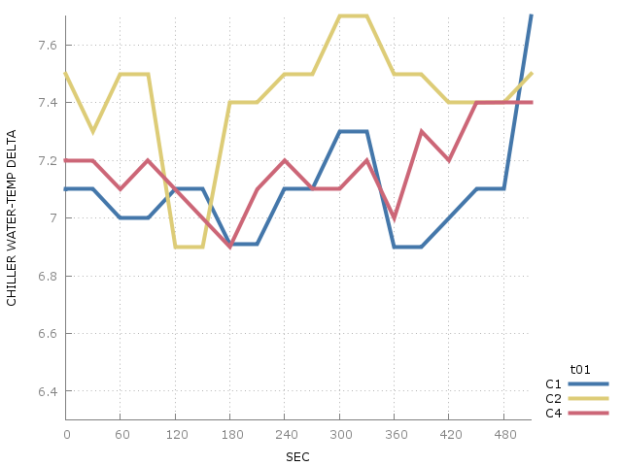
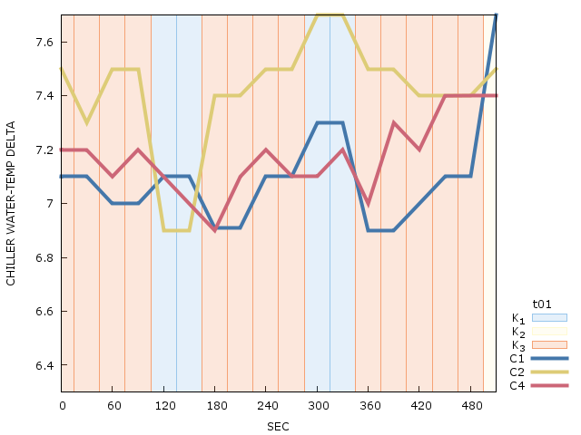
Time-correlated Cluster Charts
On the left – low density chiller temperature delta chart
On the right – the associated time-correlated chart

Slide 8
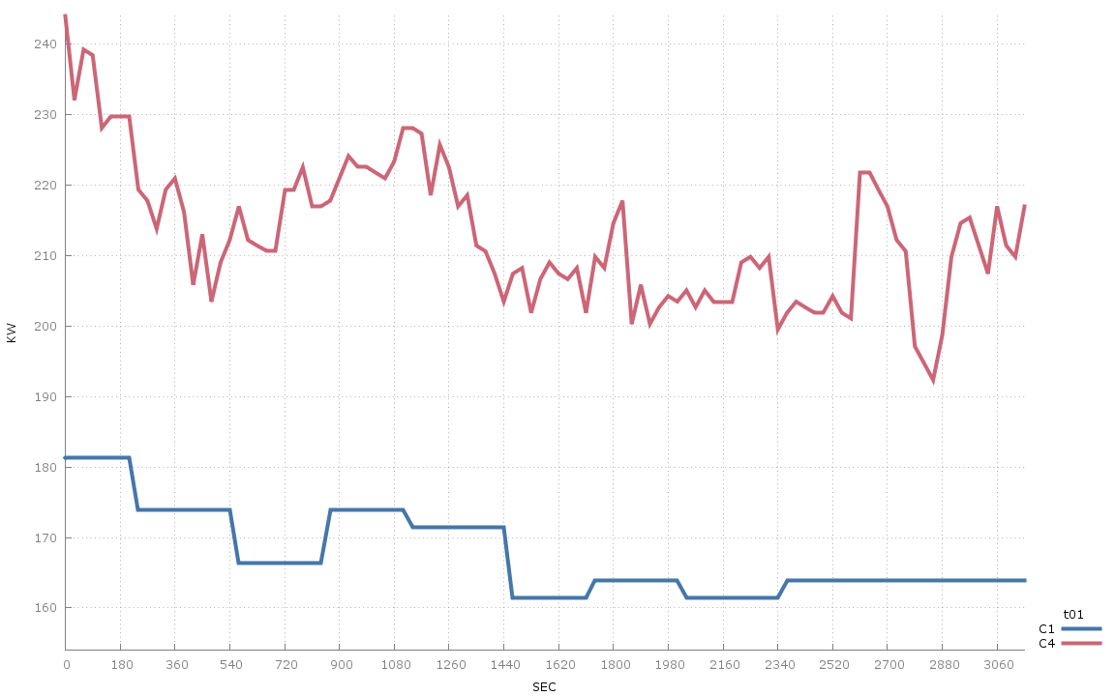
Chiller Power (KW) Chart, HD Data

Slide 9
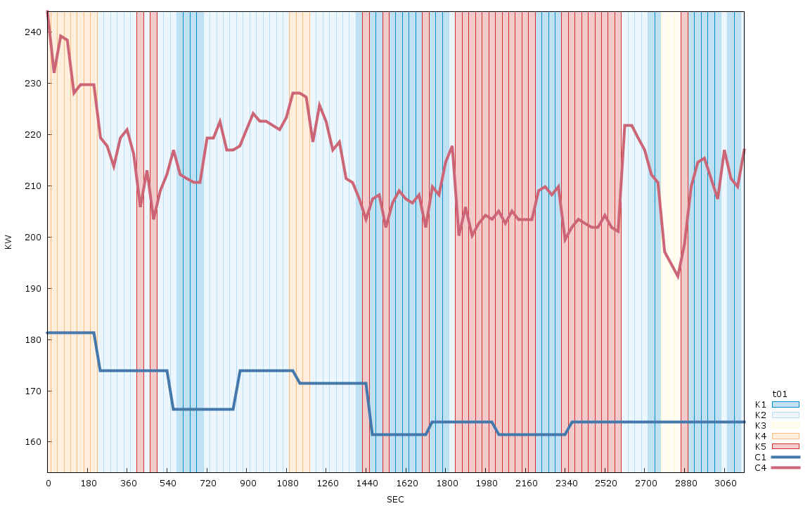
Associated Time-correlated Cluster Chart

Slide 10
Perftrack: Data Analysis Tool
Data store and interface for managing performance data
Compares the data collected in different locations and formats in single performance analysis session
Includes interfaces to data store and scripts for automatically collecting data describing each experiment
Includes a graphical user interface
Written in C++, QT and Python

Slide 11
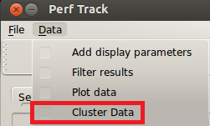
Approach 2: Perftrack Modifications
ELKI: Open source, Java-based clustering package
New menu item ‘Cluster Data’ is added to Perftrack
Perftrack is modified to generate the ELKI-compatible raw data from user filtered experiment data using GUI
K-Means clustering algorithm is executed on ELKI-compatible raw data using ELKI package
Perftrack displays the clusters

Slide 12
Future Work
Need more (and more accurate) data!
Perftrack:
Full integration of script work
On-the-fly data generation for ELKI
Tightly-coupled integration of ELKI
Graphical user interface enhancement
Modification of scripts to support direct connection to FRED in place of CSV file access
Experiment with motif-based cluster analysis (this would require more data)

